Slide 2
AUTOMATIC
DOOR HANDLE STERILIZER
PRODUCT INTRODUCTION

Slide 3
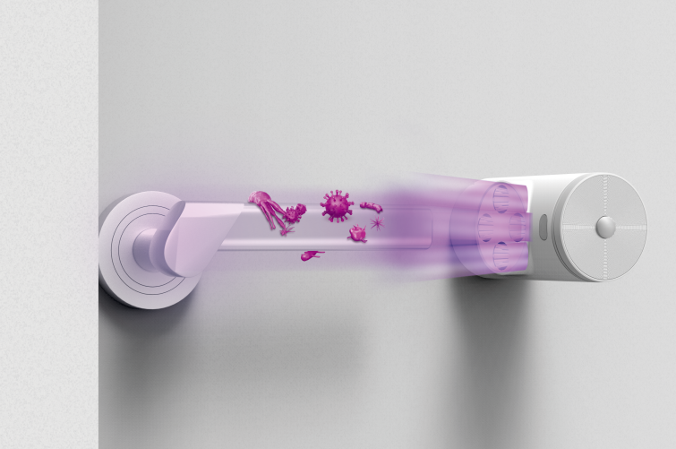
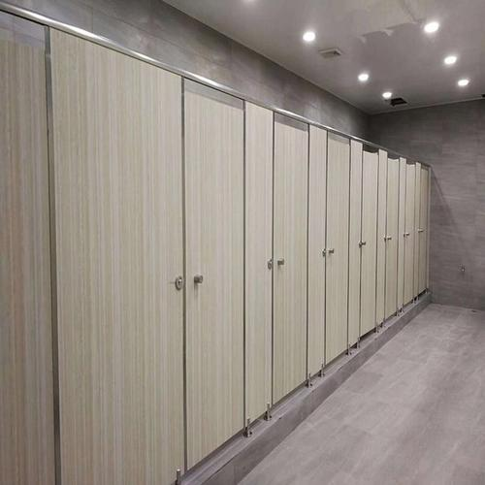
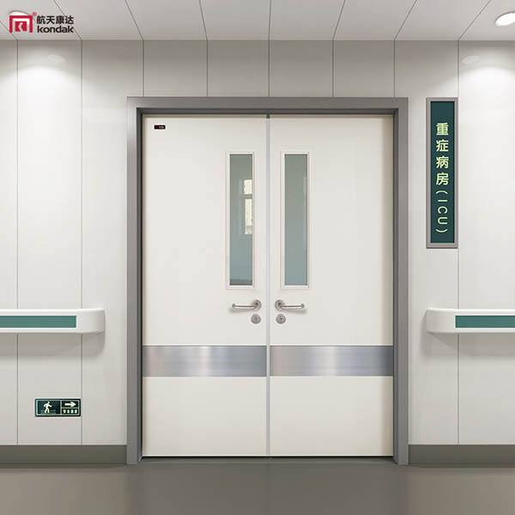
HIGH RISK OF CROSS-INFECTION
FROM PUBLIC DOOR HANDLES
Office Door Handles
Bathroom Door Handles
Hospital Door Handles
Office door handles touched by
different crowds frequently, with high health risks.
Bathrooms are full of germs, disinfect the door handles to make washing hands work
Door handles in hospital rooms and operating rooms have much possibility of carrying germs.

Slide 4
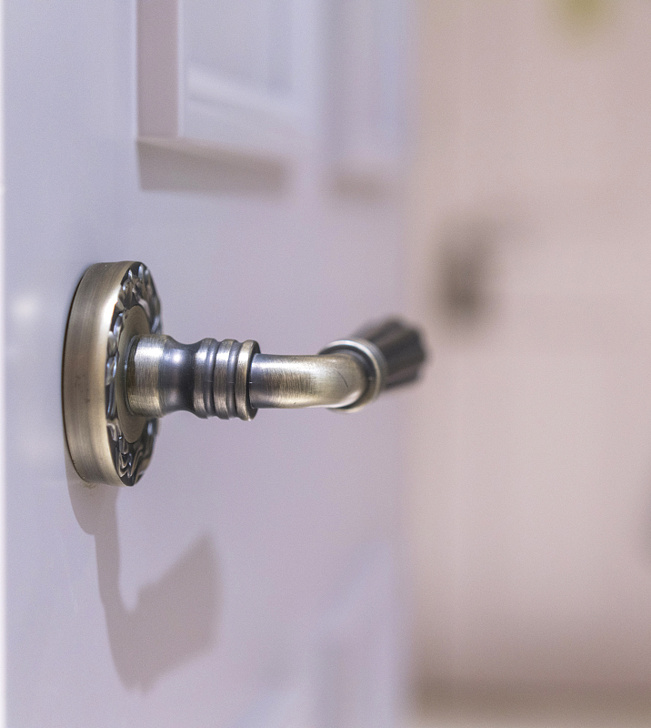
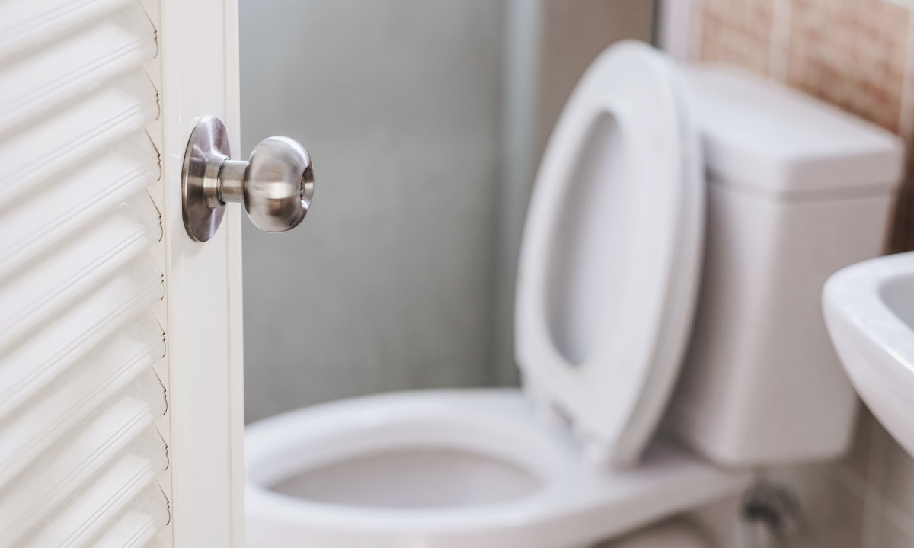
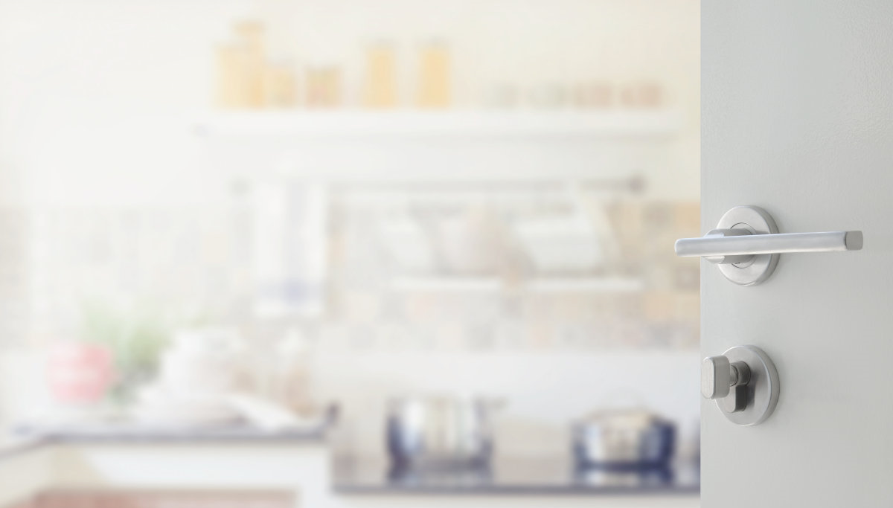
HOME DOOR HANDLES
ALSO CONTAINS GERMS
Living Room
Door Handle
Bathroom
Door Handle
The First thing you touch coming home is the door handle, leaving the germs outside while you touch it.
Door handles of Kitchen, bathroom can easily transmit germs into face or mouth if they are not disinfected regularly.
Kitchen
Door Handle

Slide 5
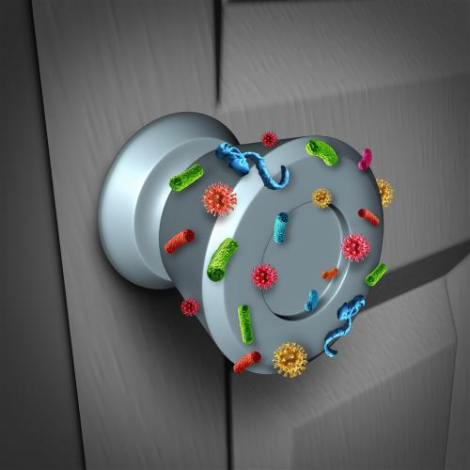
ANTI-COVID-19,
DOOR HANDLES NEED DISINFECTION
Public door handles are becoming the carrier of germs and bacteria, each handle contains 2 million germs on average. They can be transmitted to each other and cause infections.

Slide 6
AUTOMATIC
DOOR HANDLE STERILIZER
A sterilizer keeping your hands away from germs
Automatic Sterilization
Sterilization is triggered every time door handle is touched
Human Radar Safety Detector
Sterilization automatically postpones when people are within 2 meters, and it resumes when people go away
Easy Installation
Installation completes within 10 seconds, and removal within 1 second
Strong Battery Life
After one full charge, it can work for 30 days continuously

Slide 7
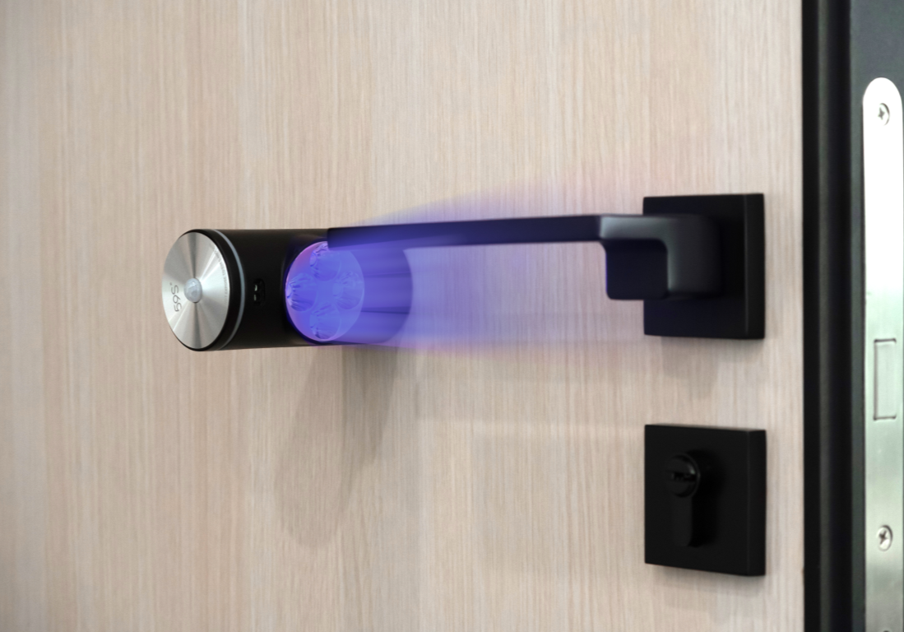
AUTOMATICALLY STERILIZE,
AFTER EACH TOUCH
59S Automatic Door Handle Sterilizer can detect if the handle is used, and will start the disinfection after sensing people leave.

Slide 8
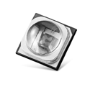
UVC LED TECHNOLOGY
KILLS 99.9% GERMS
UVC LED is the leading sterilization technology worldwide,
59S products are using the UVC light from LED chips to destroy germs DNA/RNA Physically.
What is UVC LED：
Using LED technology to integrate UV with a wavelength of 260-280 nm in the light spectrum into chips to produce "artificial sunlight".
This wavelength of UV light can penetrate the cell membrane and nucleus of organisms, destroy DNA (deoxyribonucleic acid) or RNA (ribonucleic acid), to achieve physical sterilization;
UVC LED rays can kill various germs, such as bacterial propagules, spores, viruses, fungi, etc., and can reach 99.9% sterilization rate.
99.9% Sterilization Rate
Low Power Consumption
Only 1%-5% of the mercury lamps
Physical Sterilization
Ozone-free, Chemical-free
UV Energy Increased by 50%
Quick Disinfection
1/10 timing needed to compare with
traditional mercury lamp
10000 hours Lifespan

Slide 9
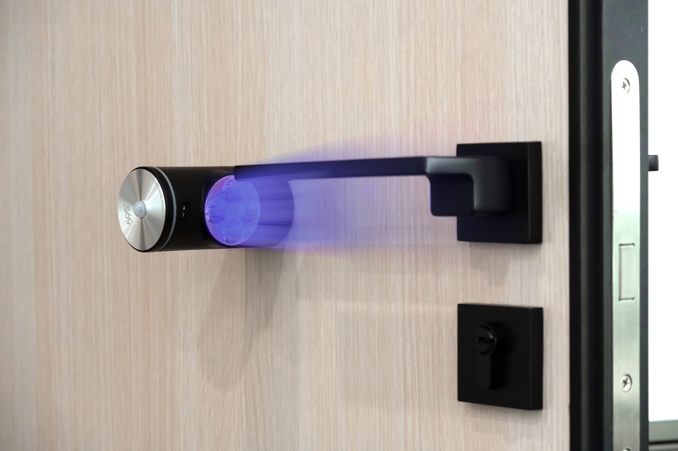
SMART DESIGN
TO ENSURES SAFETY-USE
Human Radar Safety Detector allows the sterilizing process stop to work when sensing human body around within 2m, and will automatically back to work after people leave.
When sterilization starts, beep and indicator light flashes for double reminding
Chemical-free, mercury-free, ozone-free

Slide 10
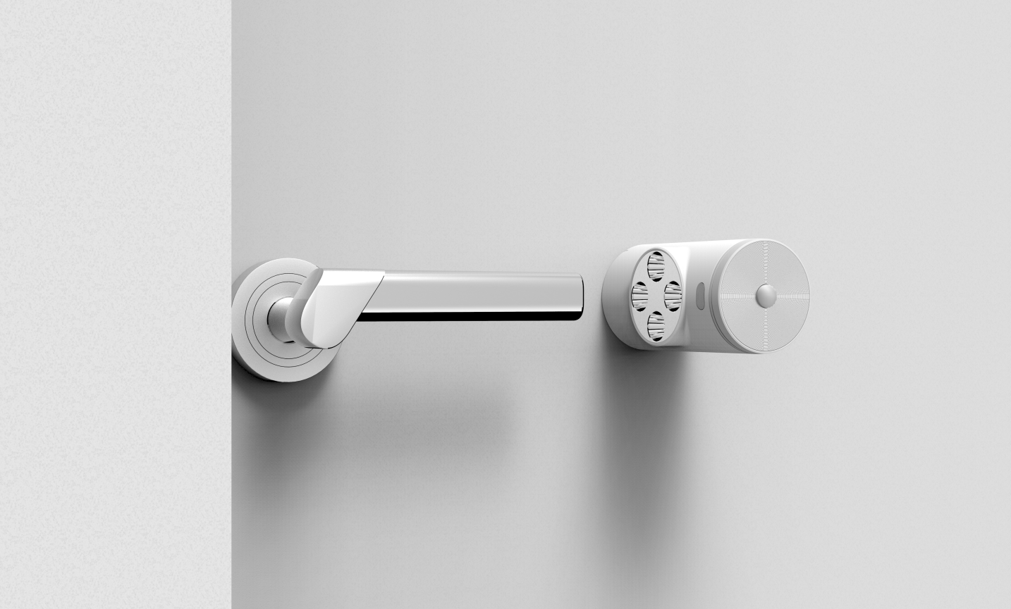
EASY INSTALLATION
COMPLETE IN 10”, REMOVAL WITHIN 1”
Installation with glued, screwed.
Easy to to install and removal within 1 second.
1. Take out the product back plate, screwed or glued the back plate onto door (30-50mm distanced from door handle).
2. Fully charge the Door Handle Sterilizer and lock into the back plate socket then turn 15°.
3. Adjust the Sterilizer to aim correctly at the door handle.

Slide 11
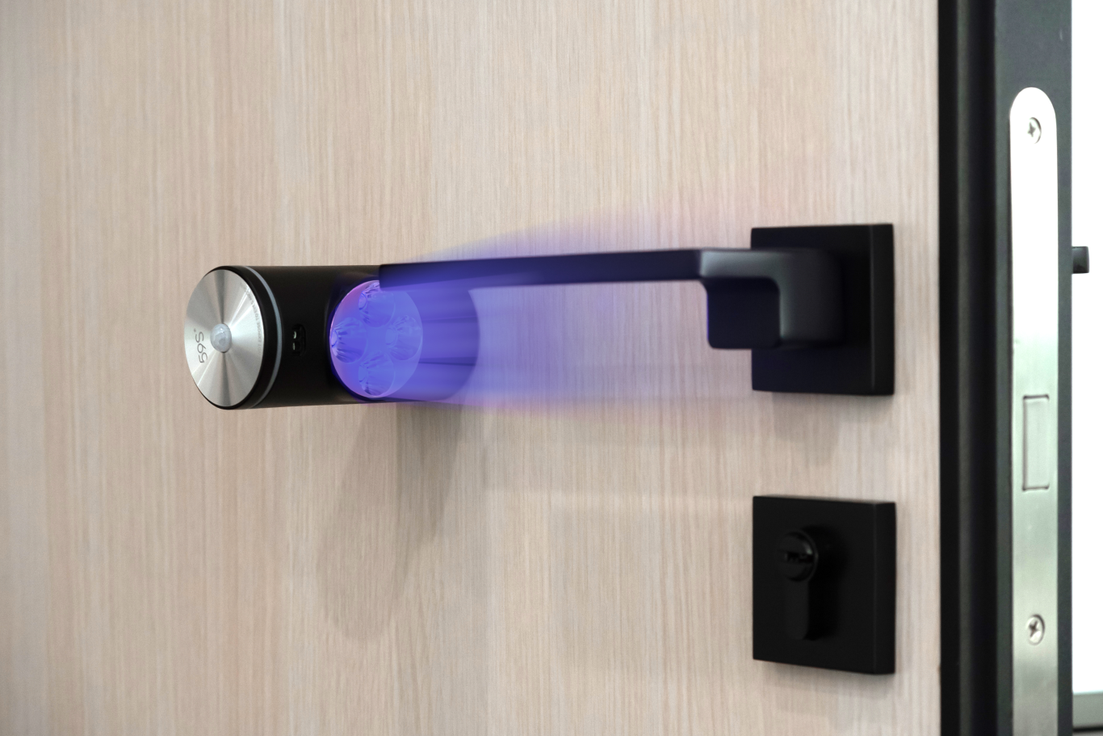
STRONG BATTERY
USED FOR 30 DAYS WHEN FULLY CHARGED
Built-in 2500 mAh lithium battery, can be used for 30 days when fully charged.

Slide 12
PRODUCT DETAILS
Adhesive Fixed Base
Indication Circle Light
Electroplated Spotlight Cover
Induction Device
Aluminum Alloy Top Cover
Infrared Sensor Window

Slide 13
SPECIFICATION
Color：White, Black
Power Port：USB-micro
Input Voltage：5V DC
Power：5W
Infrared Sensor Detection Distance：10cm
Recognition Rate：＞95%
Disinfection power：2.5w
UV LED Bead Qty：4
Battery Capacity：2500mAH
Disinfection times：250 times

Slide 14
About 59S

Slide 15
59S IS THE GLOBAL LEADER ASLO PIONEER
in UVC LED STERILIZATION
Every 80% of UV LEDs comes from 59S.
World's first UV LED sterilizing bag is developed, produced, and sold by 59S! It’s also the best seller around the world!
World's first UV LED sterilizing wand developed, produced, and sold by 59S! It’s also the best seller around the world!
World's first UVC LED MP company
World's biggest UV LED company
59S promotes the civilianization of UVC LED development with innovative technology, and push professional UVC LED sterilization technology into thousands of families.

Slide 16
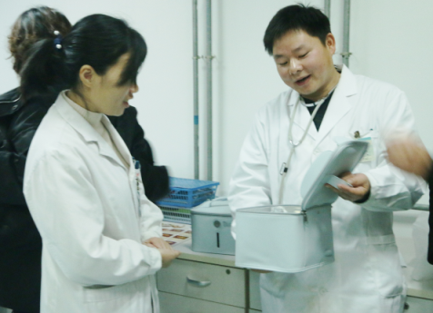
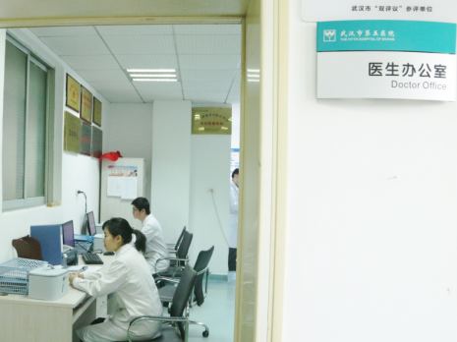
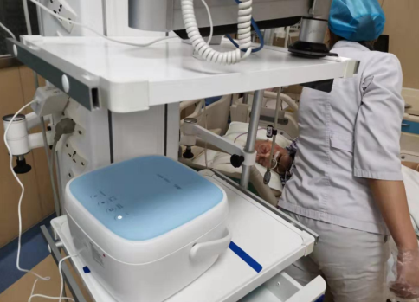
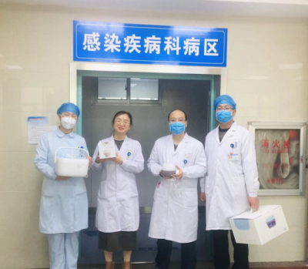
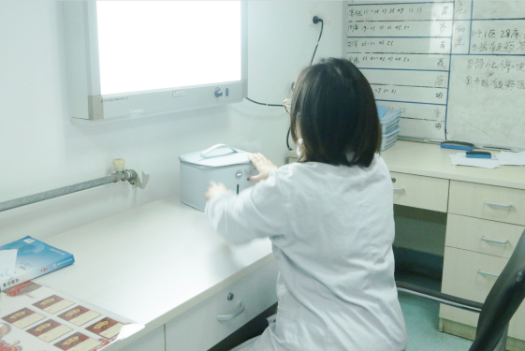
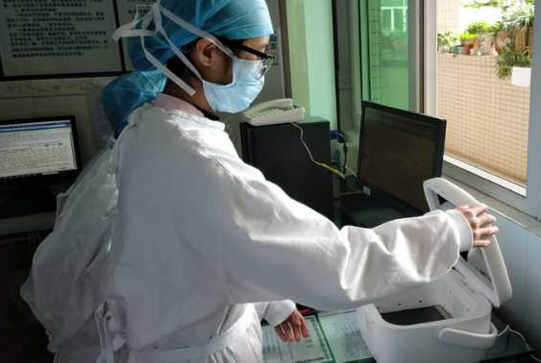
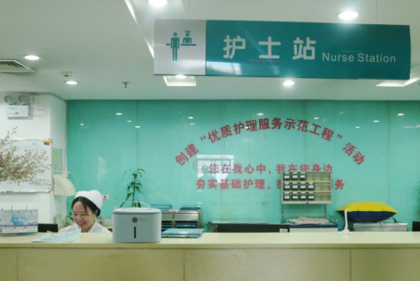
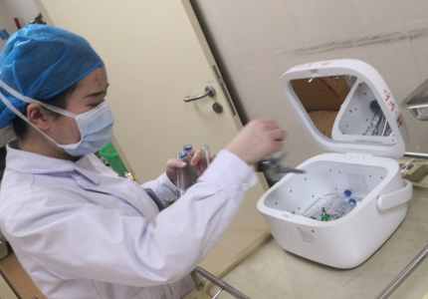
RECOGNIZED BY
PROFESSIONAL MEDICAL INSTITUTIONS
59S recognized by many hospitals nationwide, Provides more protection for doctors and patients.
Germs are invisible, Sterilizers need to be professional
59S is Recognized by 1100 Hospitals

Slide 17
59S AWARDS

Slide 18
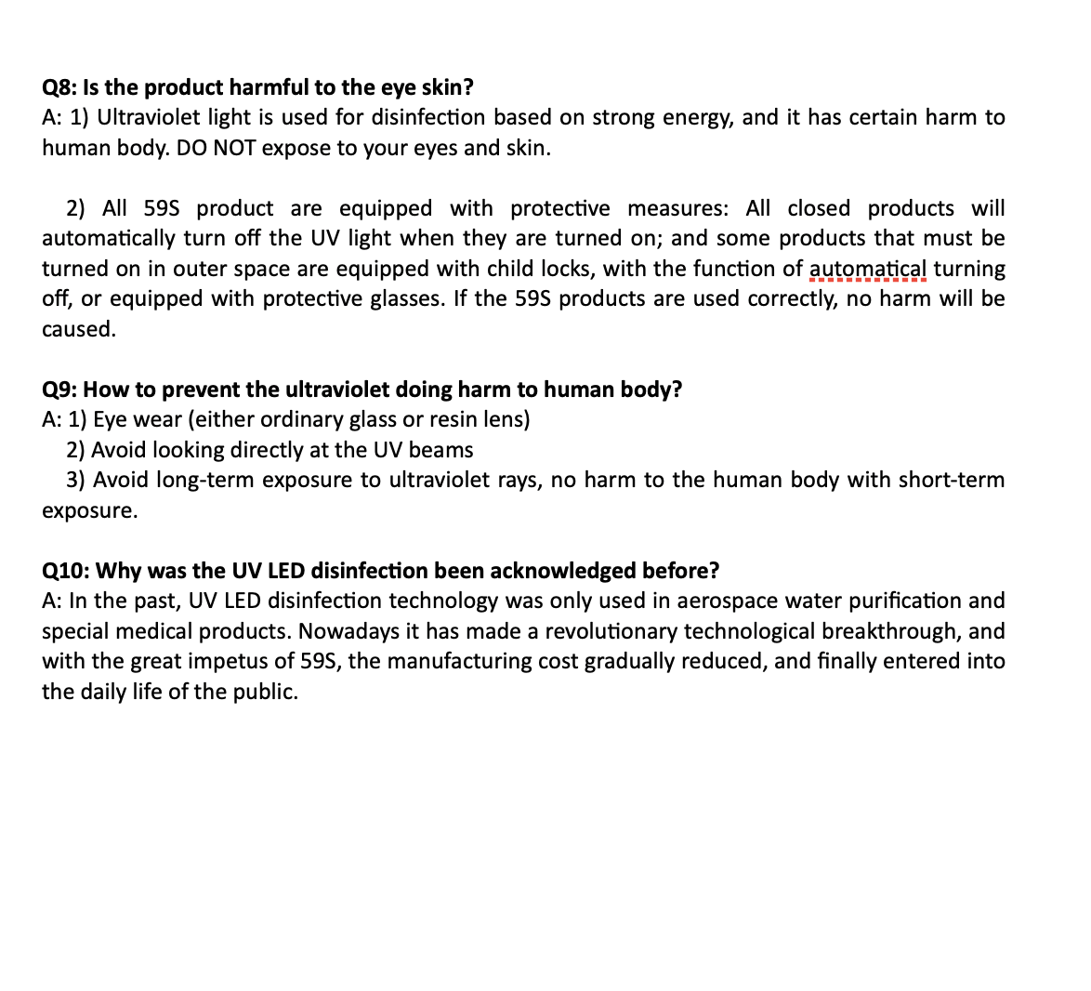
Q&A for 59S LED Disinfection

Slide 19
59S Automatic Door Handle Sterilizer
Safe and Convenient with UVC sterilization technology
Reduce cross infection between opening and closing the door
Every door handle needs
a 59S Automatic Door Handle Sterilizer

